Slide 1

Deep Learning with

Slide 2
“What is deep learning?”

Slide 3
Machine learning is turning things (data) into numbers and finding patterns in those numbers.
The computer does this part. How?
Code & math.
We’re going to be writing the code.

Slide 4

Machine Learning vs. Deep Learning
Artificial Intelligence
Machine Learning
Deep Learning

Slide 5
(maybe not very simple…)
“If you can build a simple rule-based system that doesn’t require machine learning, do that.”
— A wise software engineer… (actually rule 1 of Google’s Machine Learning Handbook)

Slide 6

What deep learning is good for
Problems with long lists of rules—when the traditional approach fails, machine learning/deep learning may help.
Continually changing environments—deep learning can adapt (‘learn’) to new scenarios.
Discovering insights within large collections of data—can you imagine trying to hand-craft rules for what 101 diSerent kinds of food look like?

Slide 7

What deep learning is not good for
(typically)
When you need explainability—the patterns learned by a deep learning model are typically uninterpretable by a human.
When the traditional approach is a better option — if you can accomplish what you need with a simple rule-based system.
When errors are unacceptable — since the outputs of deep learning model aren’t always predictable.
When you don’t have much data — deep learning models usually require a fairly large amount of data to produce great results.
(though we’ll see how to get great results without huge amounts of data)

Slide 8
“What are neural networks?”

Slide 9




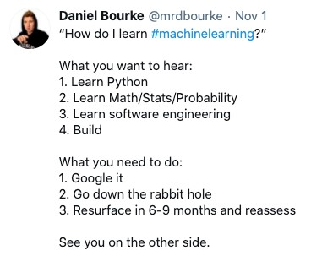

Neural Networks
(a human can
understand these)
Ramen, Spaghetti
(before data gets used
Each of these nodes is called a “hidden unit” or “neuron”.
with a neural network,
it needs to be turned
into numbers)
[[116, 78, 15],
[117, 43, 96],
[125, 87, 23],
…,
[[0.983, 0.004, 0.013],
[0.110, 0.889, 0.001],
Not a diaster
[0.023, 0.027, 0.985],
…,
(choose the appropriate
“Hey Siri, what’s the weather today?”
neural network for your
problem)
Learns representation
(patterns/features/weights)
Inputs
Numerical encoding
Representation outputs
Outputs

Slide 10
Anatomy of Neural Networks
Overall architecture
Input layer
(data goes in here)
# units/neurons = 2
Output layer
(outputs learned representation or prediction probabilities)
# units/neurons = 1
Each layer is usually combination of
linear (straight line) and/or non-
Hidden layer(s)
(learns patterns in data)
# units/neurons = 3
linear (not-straight line) functions

Slide 11
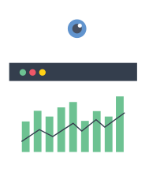

Types of Learning
Supervised Learning
Unsupervised & Self-supervised Learning
Transfer Learning
We’ll be writing code to do these,
but the style of code can be adopted across learning paradigms.

Slide 12


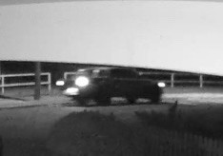
Deep Learning Use Cases
(some)
“Hey Siri, who’s the biggest big dog of them all?”
Speech recognition
Sequence to sequence (seq2seq)
Recommendation
Translation
To: daniel@mrdbourke.com Hey Daniel,
To: daniel@mrdbourke.com Hay daniel…
This deep learning course is incredible! I can’t wait to use what I’ve learned!
Not spam
C0ongratu1ations! U win $1139239230
Spam
Classi<cation/regression
Computer Vision
Natural Language Processing (NLP)

Slide 14

What is PyTorch?
Most popular research deep learning framework*
Write fast deep learning code in Python (able to run on a GPU/many GPUs)
Able to access many pre-built deep learning models (Torch Hub/
torchvision.models)
Whole stack: preprocess data, model data, deploy model in your application/cloud
Originally designed and used in-house by Facebook/Meta (now open- source and used by companies such as Tesla, Microsoft, OpenAI)
*Source: paperswithcode.com/trends February 2022

Slide 15
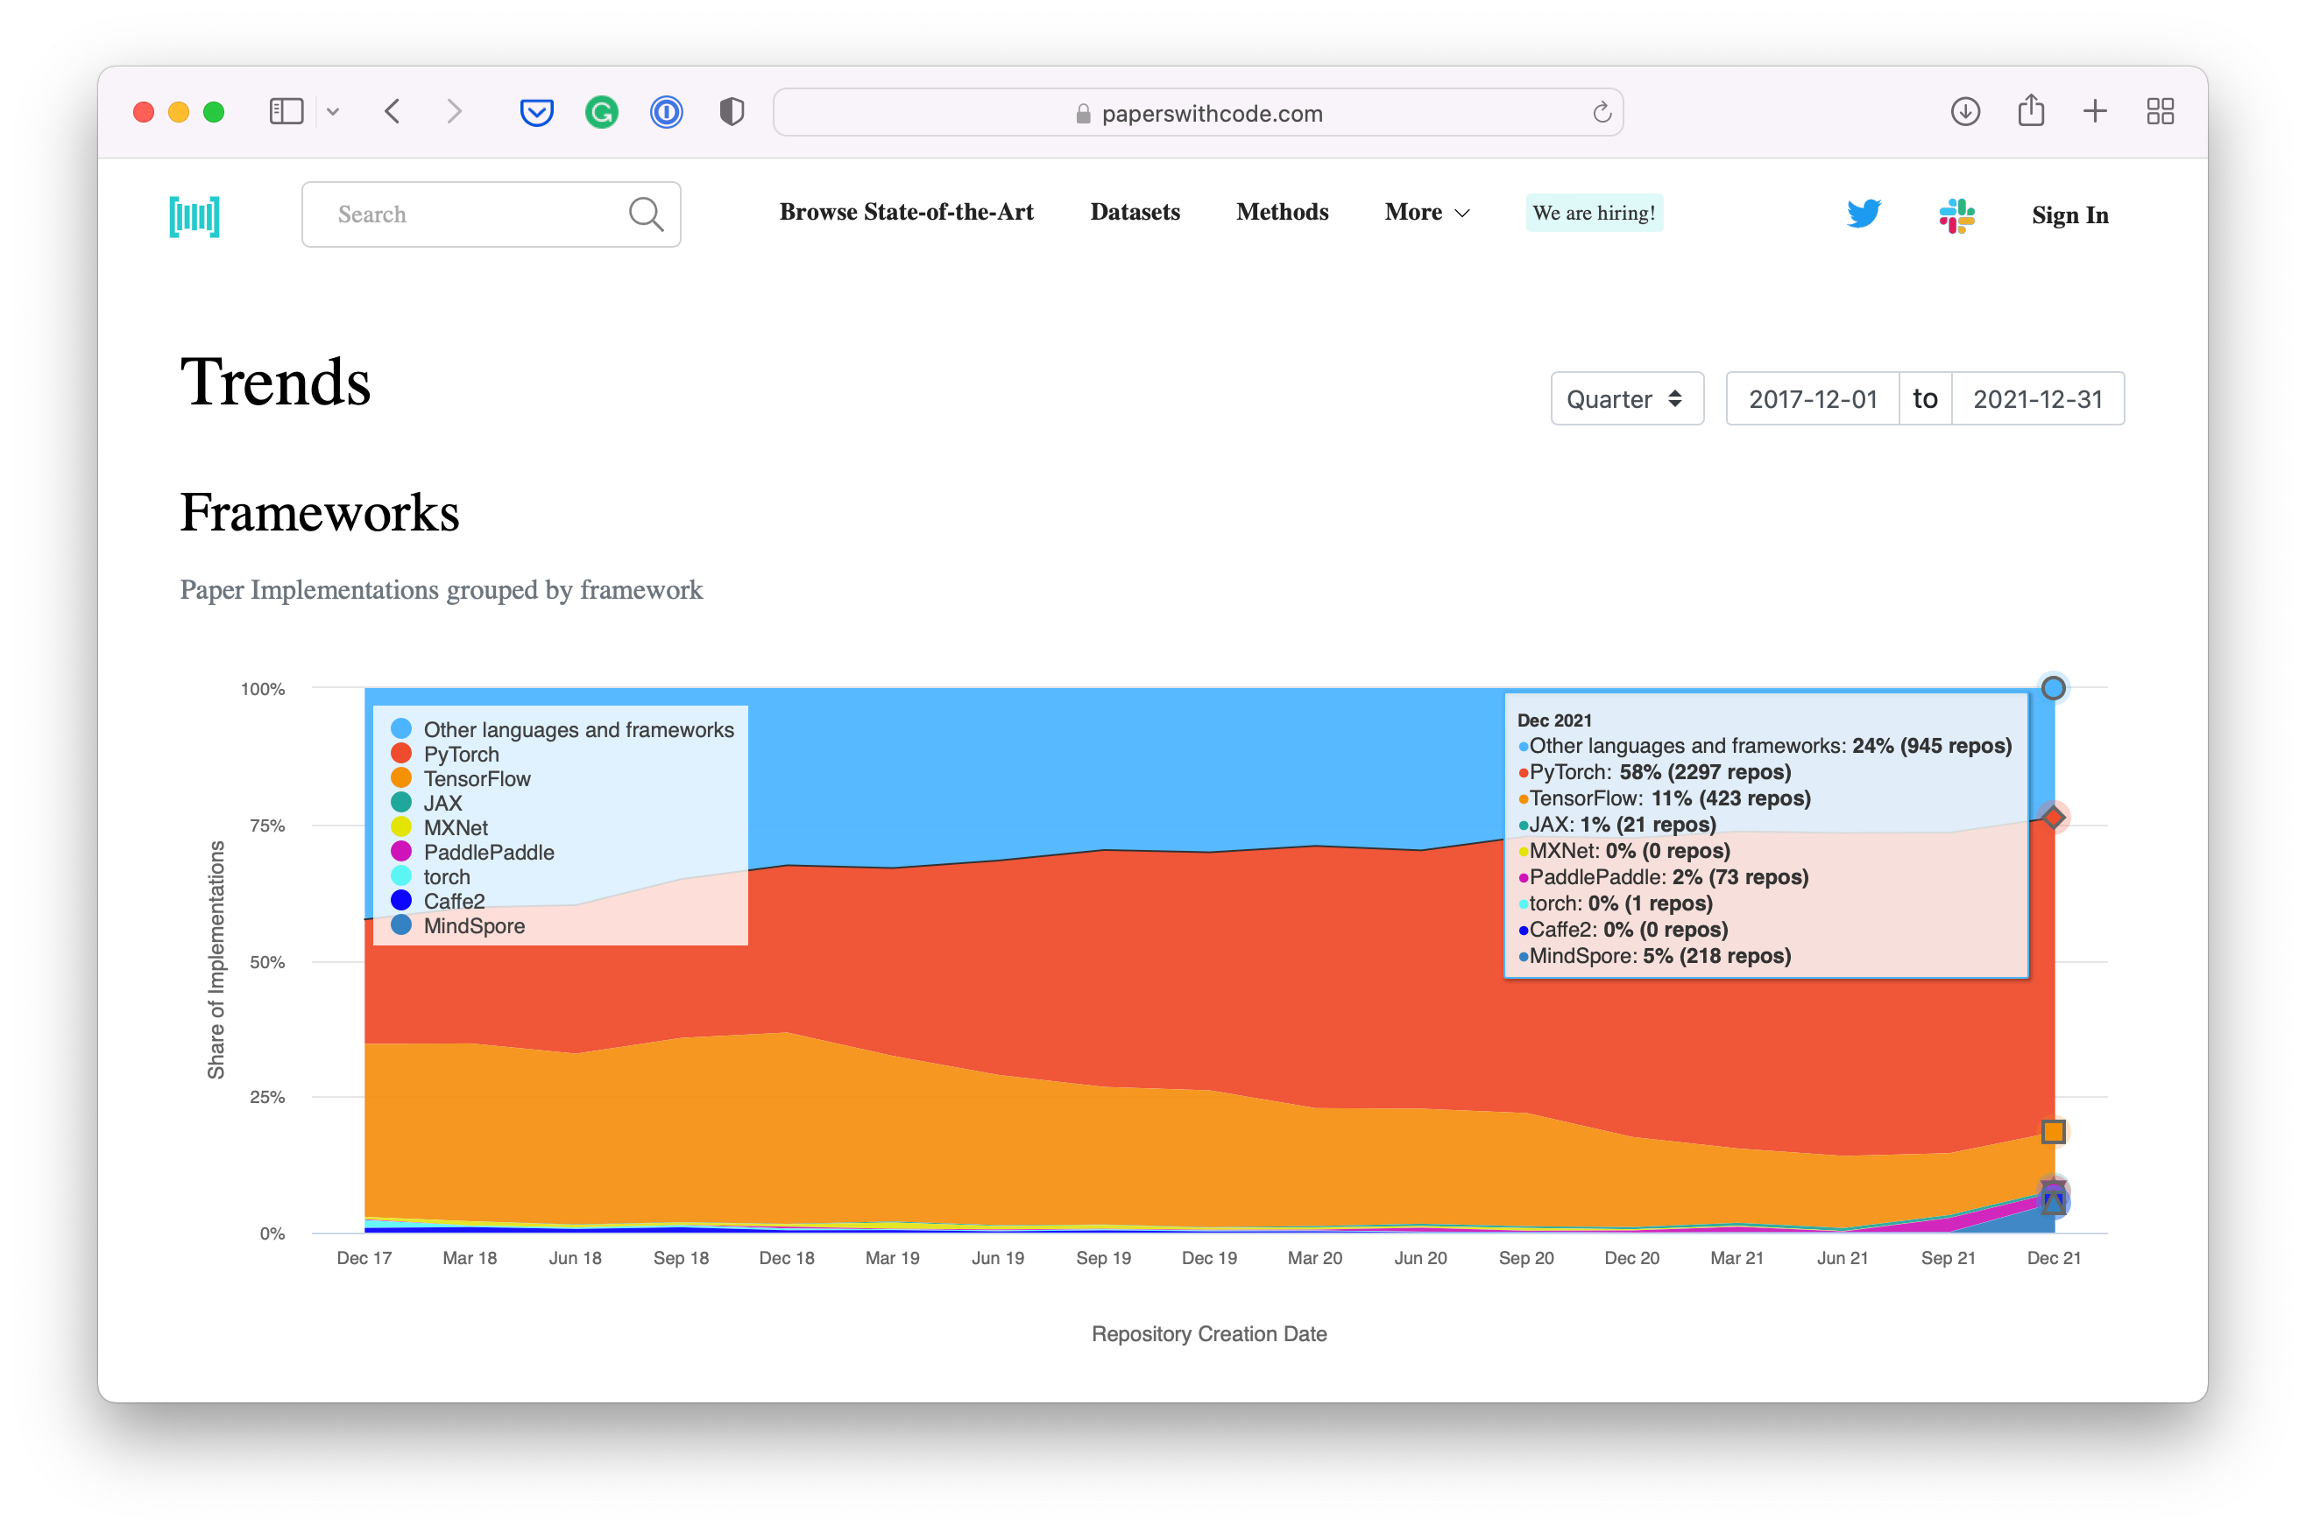

Why PyTorch?
Research favourite
Source: paperswithcode.com/trends February 2022

Slide 16
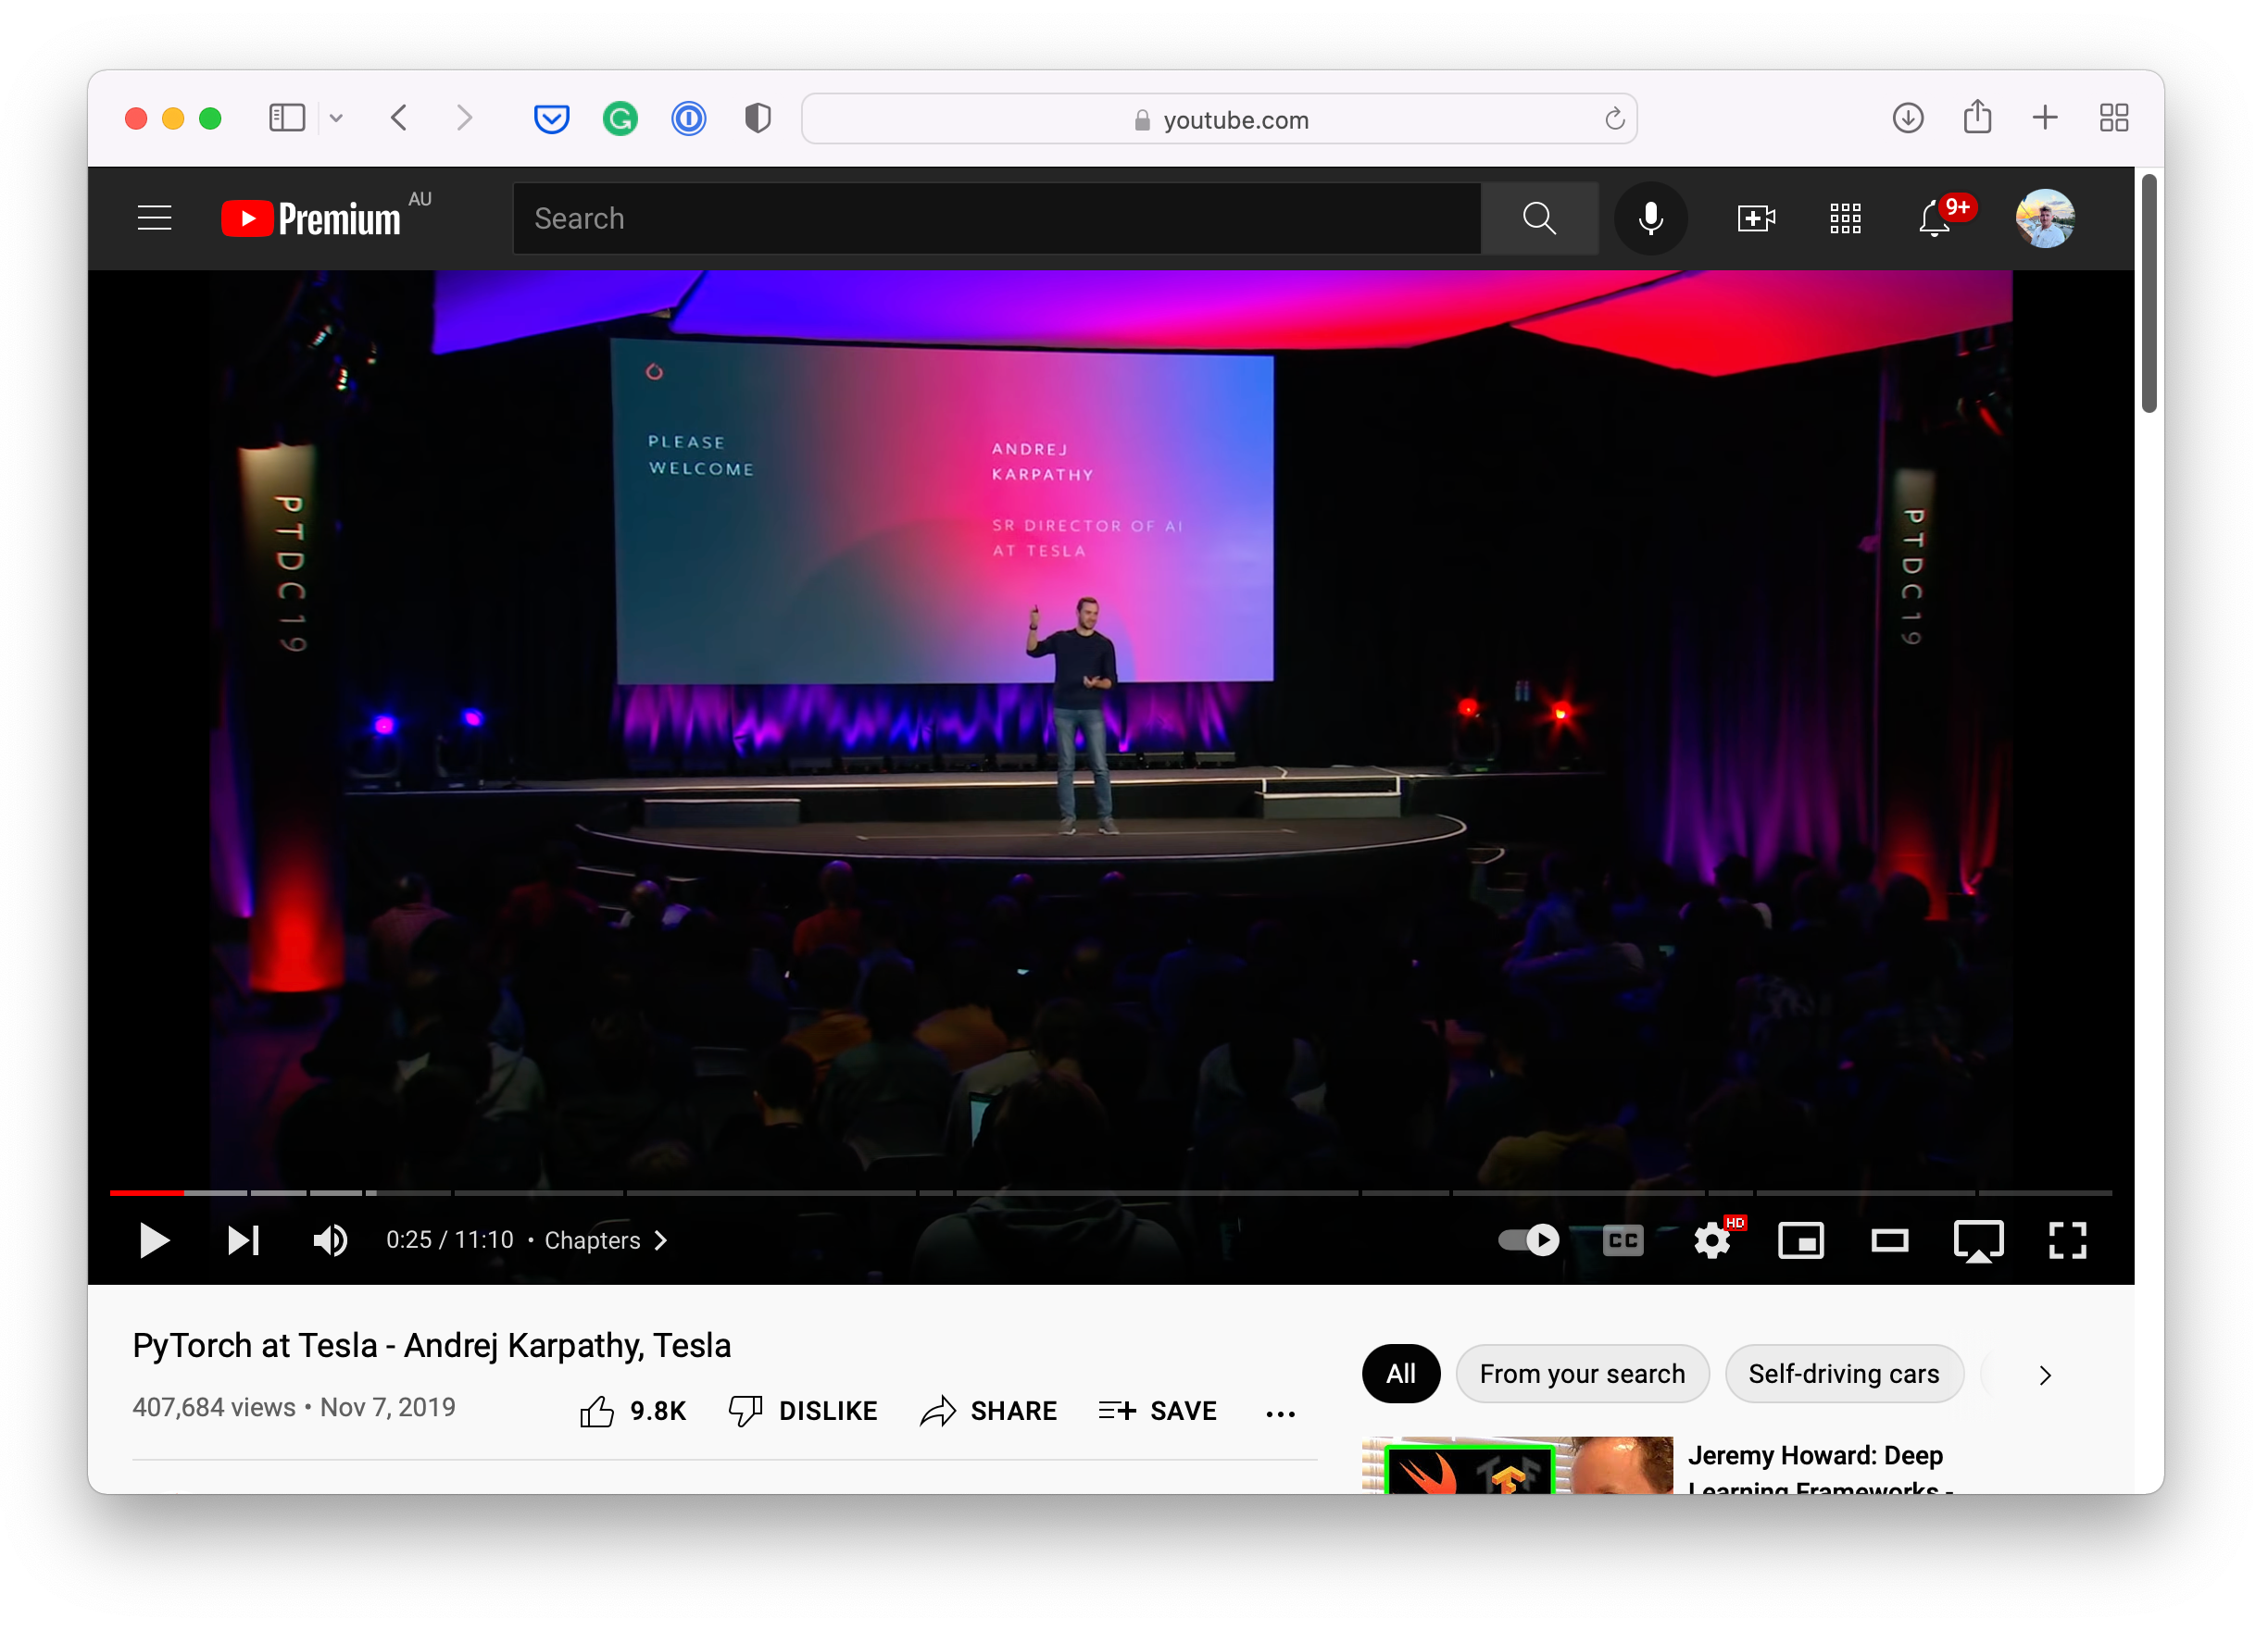
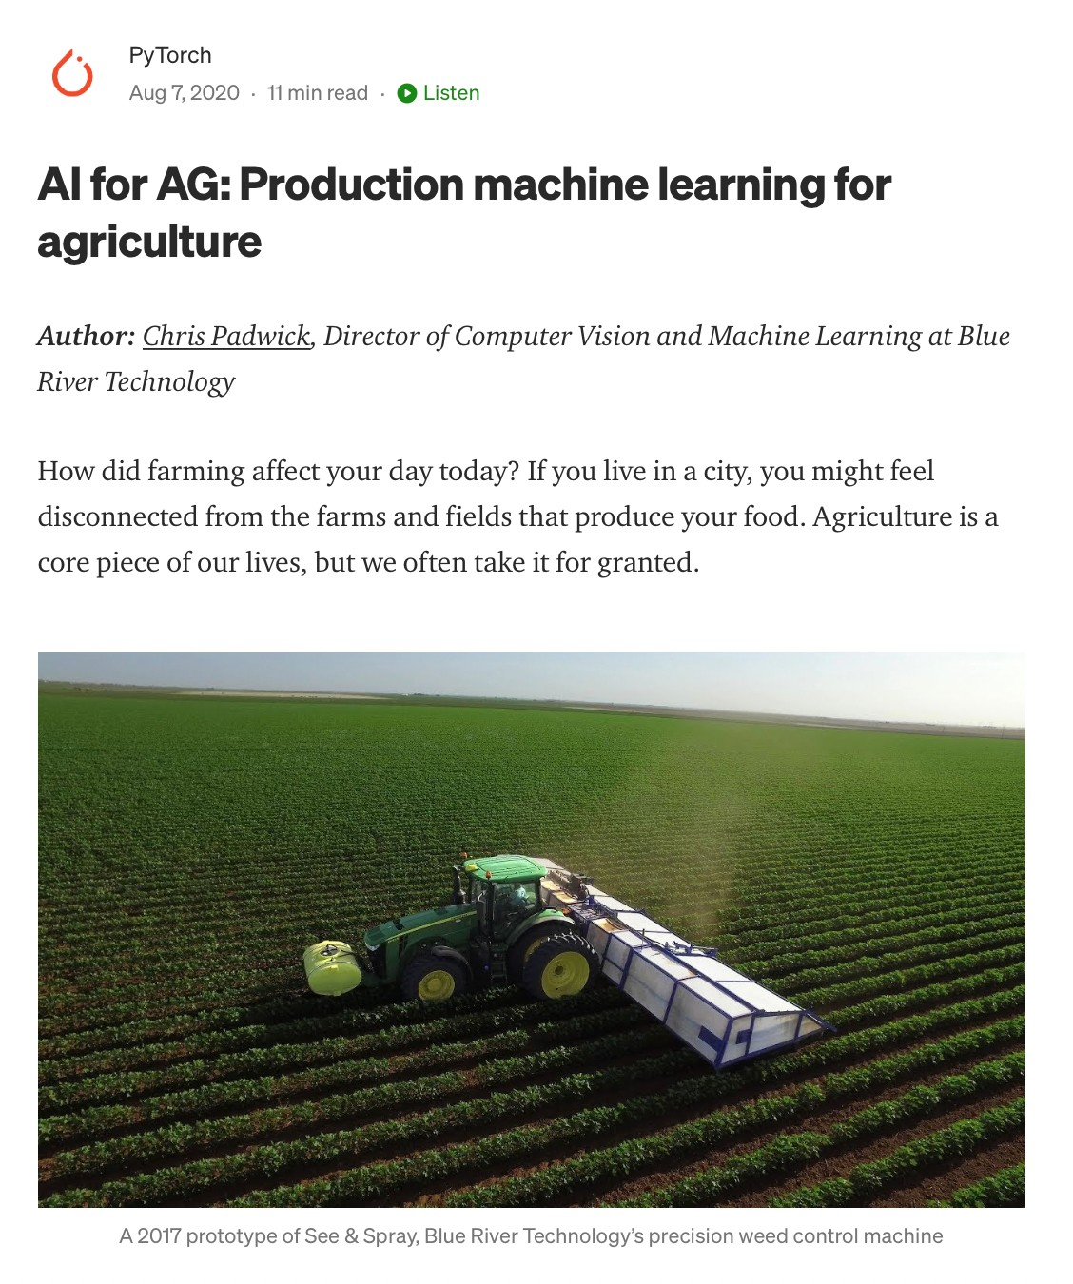


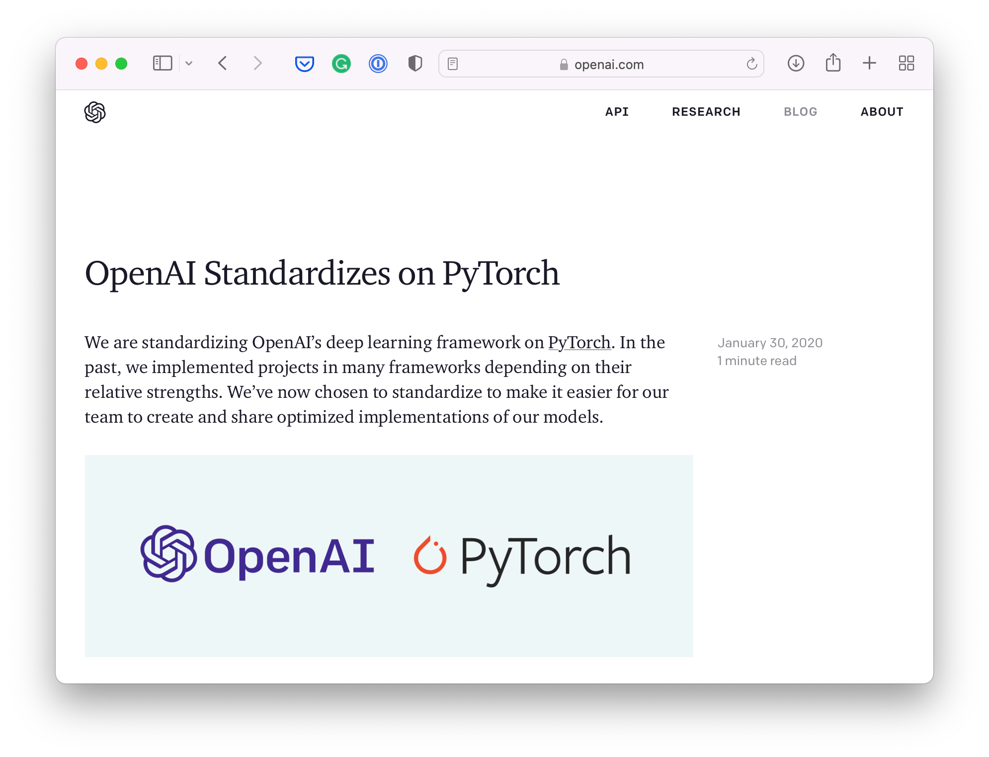

Why PyTorch?

Slide 17
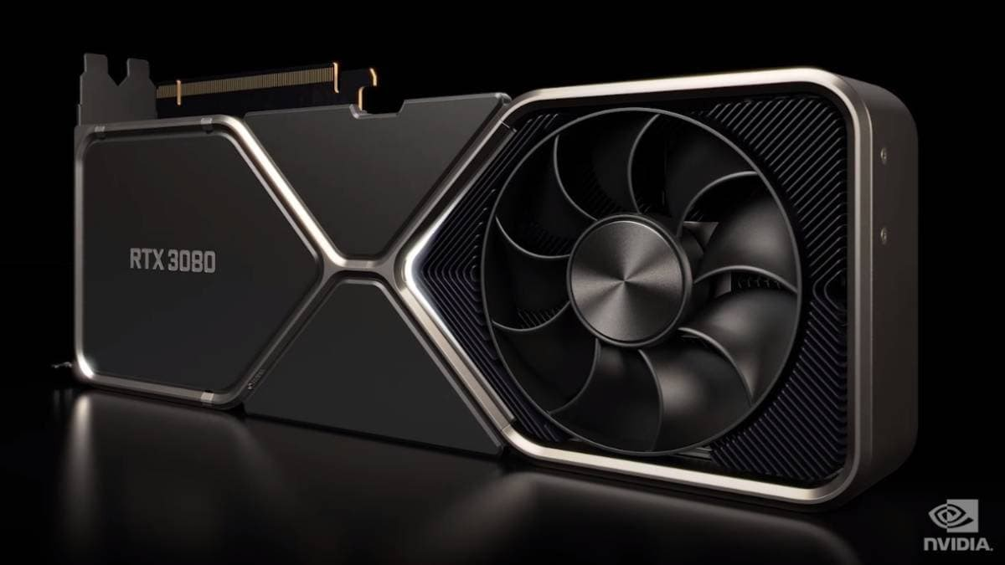
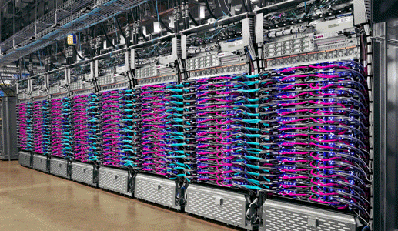
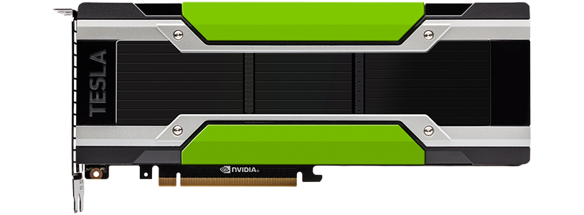
What is a GPU/TPU?
TPU (Tensor Processing Unit)
GPU (Graphics Processing Unit)

Slide 18
“What is a tensor?”

Slide 19
Neural Networks
(a human can
understand these)
Ramen, Spaghetti
(before data gets used
These are tensors!
with an algorithm, it
needs to be turned into
numbers)
[[116, 78, 15],
[117, 43, 96],
[125, 87, 23],
…,
[[0.983, 0.004, 0.013],
[0.110, 0.889, 0.001],
Not spam
[0.023, 0.027, 0.985],
…,
(choose the appropriate
“Hey Siri, what’s the weather today?”
neural network for your
problem)
Learns representation
(patterns/features/weights)
Inputs
Numerical encoding
Representation outputs
Outputs

Slide 20
These are tensors!
[[116, 78, 15],
[117, 43, 96],
[125, 87, 23],
…,
[[0.983, 0.004, 0.013],
[0.110, 0.889, 0.001],
Ramen, Spaghetti
[0.023, 0.027, 0.985],
…,
Learns representation
(patterns/features/weights)
Inputs
Numerical encoding
Representation outputs
Outputs

Slide 21
“What are we going to cover?”

Slide 22
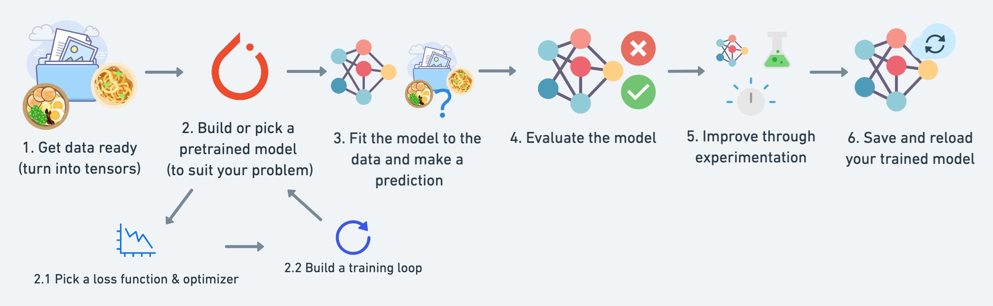
What we’re going to cover
A PyTorch workflow
(one of many)

Slide 23
Let’s code!

